Slide 1
DigiTEX - Textile digitalization based on digital education and innovative e-Tools 2020-1-RO01-KA226-HE-095335
History of smart textiles, Definitions and classification, End-users requirements and perspective in selecting the smart products
Kaunas University of Technology

Slide 2
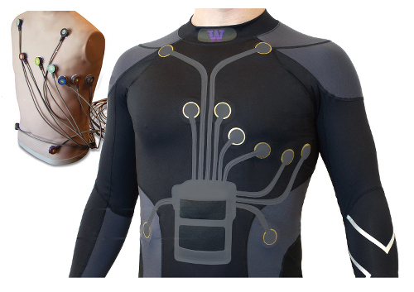
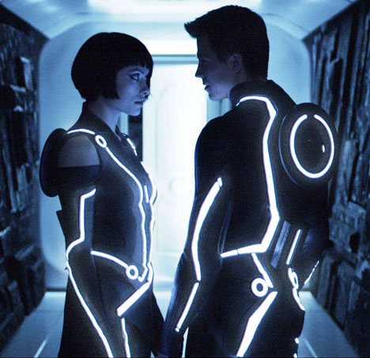
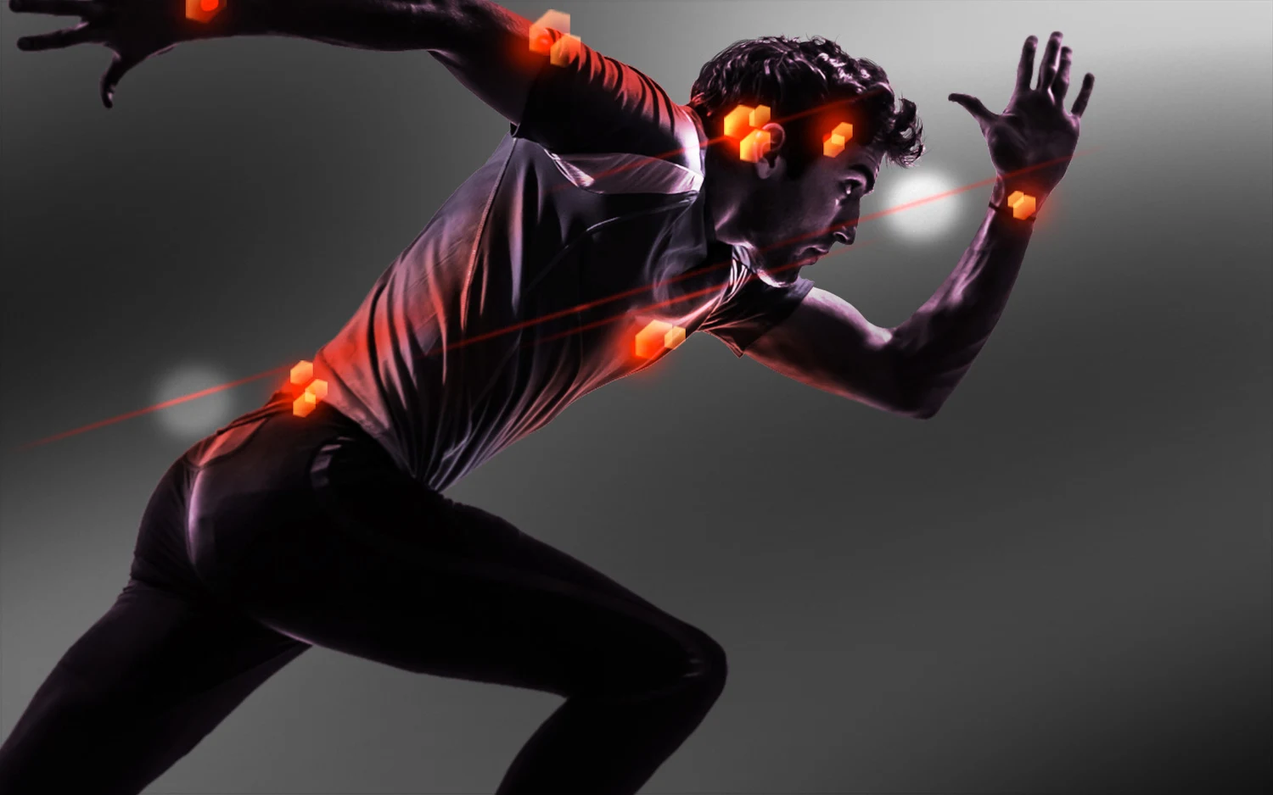
Smart textiles is composed of materials or structures that sense and react to environmental stimuli, such as those from mechanical, thermal, chemical, magnetic or others.
Smart textile for healthcare
https://www.businesspally.com/smart-textiles-in-healthcare/
Smart textiles for athlete
Smartly dressed
https://www.core77.com/posts/18716/smart-textiles-design-competition-18716
https://sporttomorrow.com/4-awesome-reasons-why-smart-textiles-improve-athlete-performance/

Slide 3
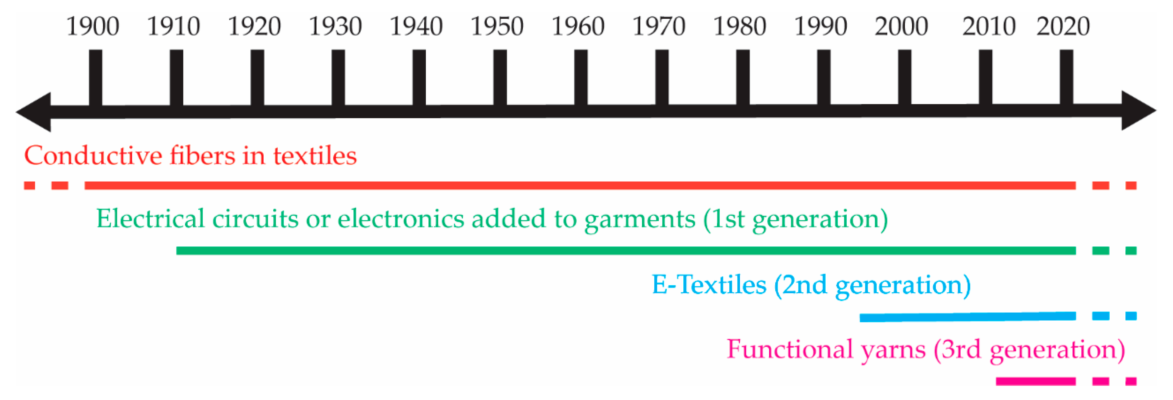
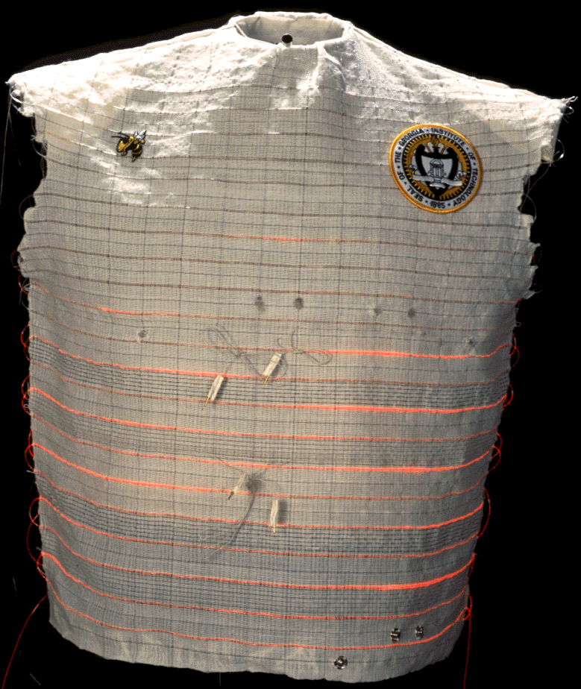
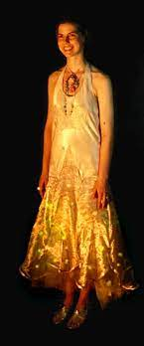
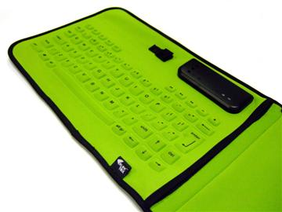
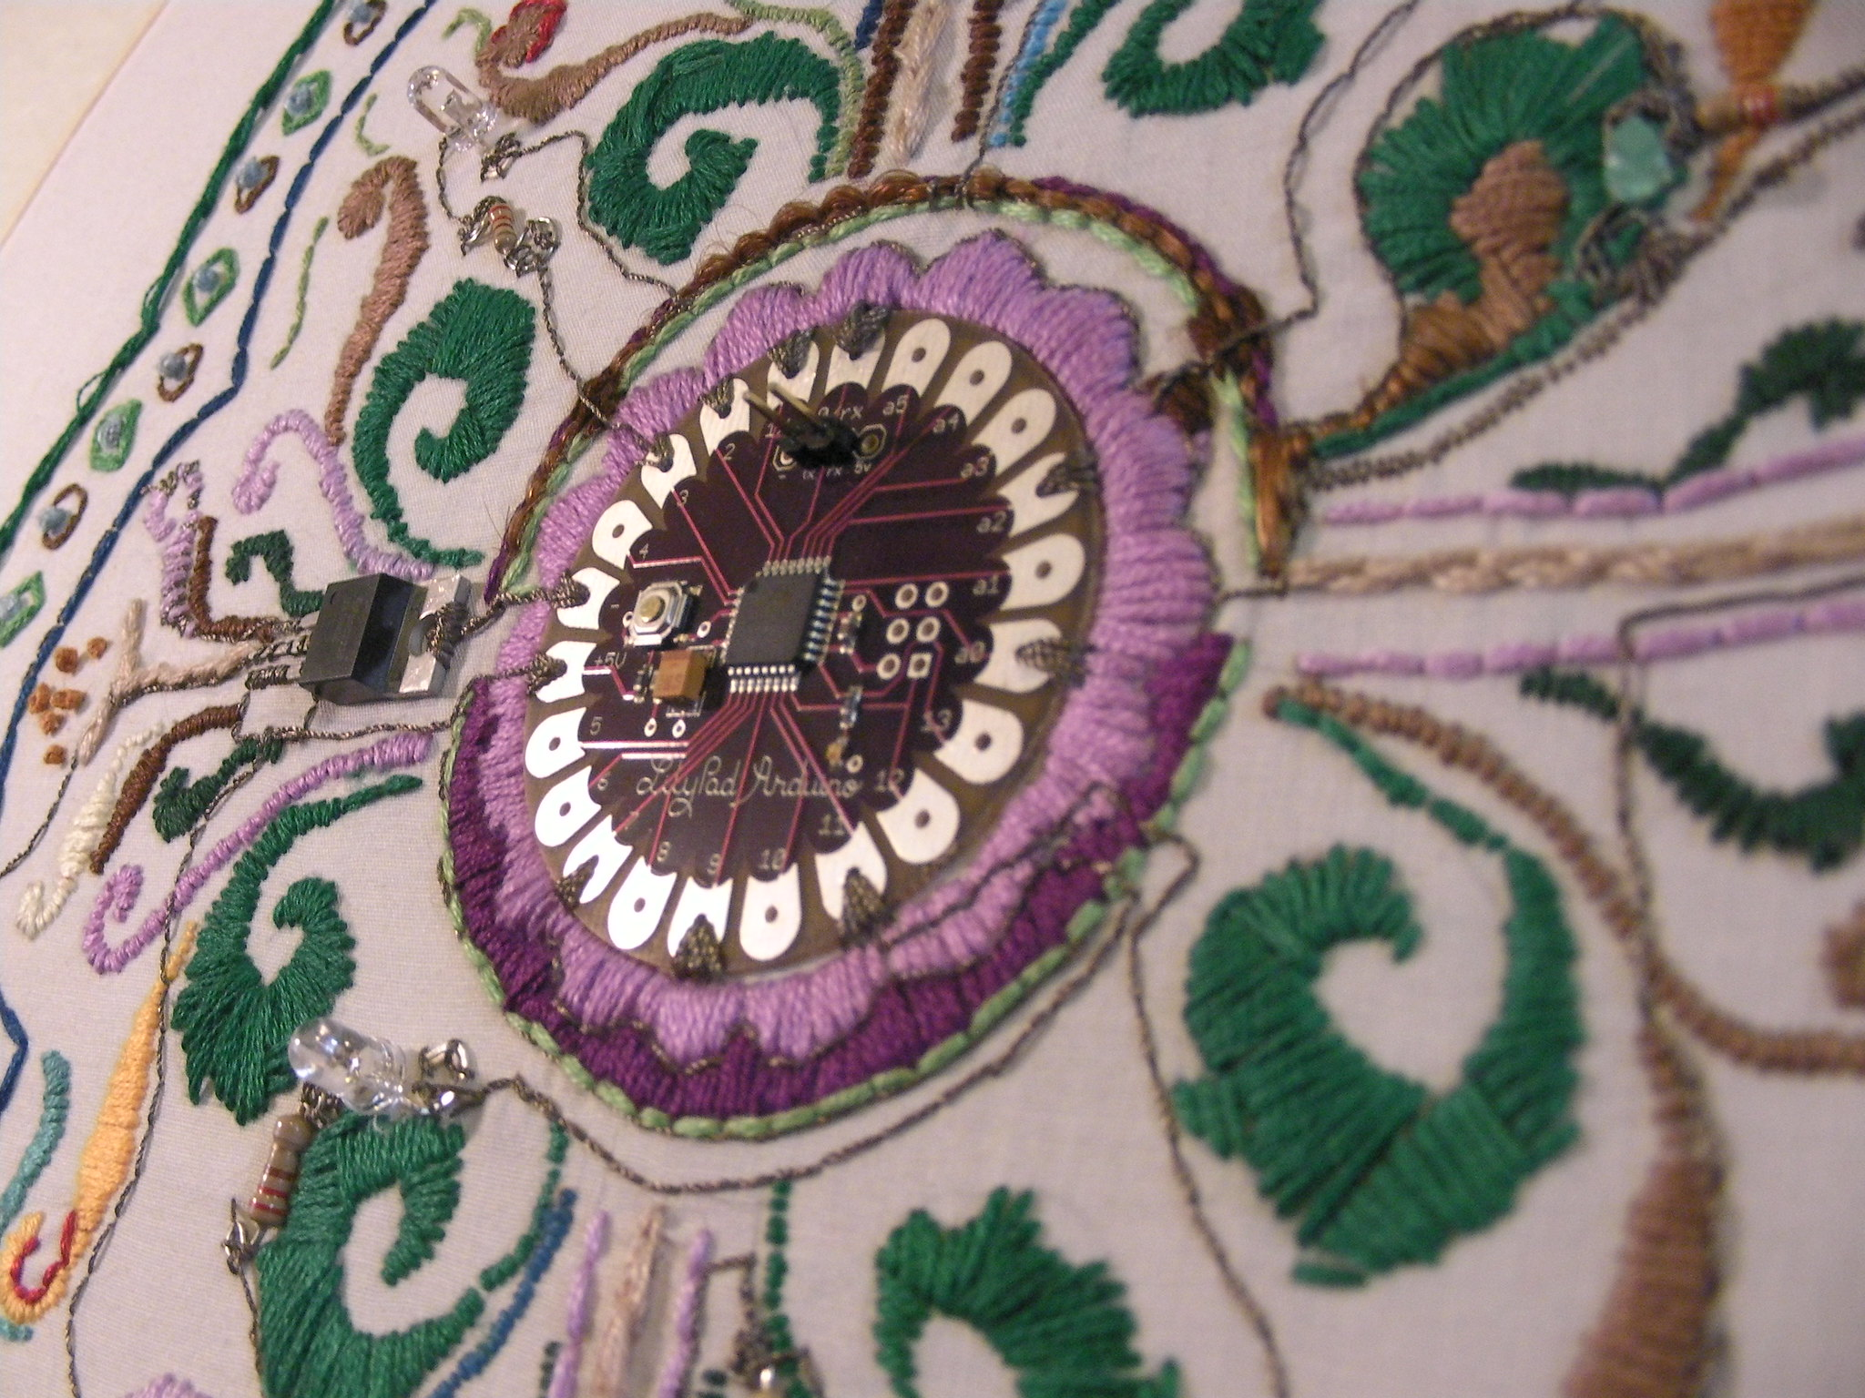
History of smart textiles
Evolution of electronic textiles over time.
Georgia Tech Wearable Motherboard
Firefly dress
Eleksen fabric keyboard for rim blackberry
Lillypad Arduino microcontroller chip integrated into a textile

Slide 4
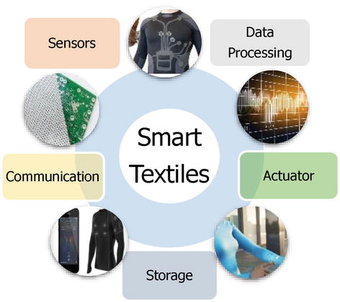
Definitions of smart textiles
The first formal definition was found as “smart textiles is composed of materials or structures that sense and react to environmental stimuli, such as those from mechanical, thermal, chemical, magnetic or other”.
According to European committee for standardization (CEN), the definition of smart textile system is: “Assembly of textiles and non-textiles integrated into a product that retains its textile properties and interacts with its environment”.

Slide 5
Classifications of smart textiles
Smart textiles
Smart materials
Integration level 1: Electronic and textile are separate unit.
Integration level 2: Electronic and textile are not separate.
Smart textiles systems
Smart structures
Integration level 3: Textile is the connection.
Integration level 4: Textile is the component.
The smart textiles can be divided into three subgroups:
Passive smart textiles
Active smart textiles
Very smart textiles
Classification based on CEN definition

Slide 6
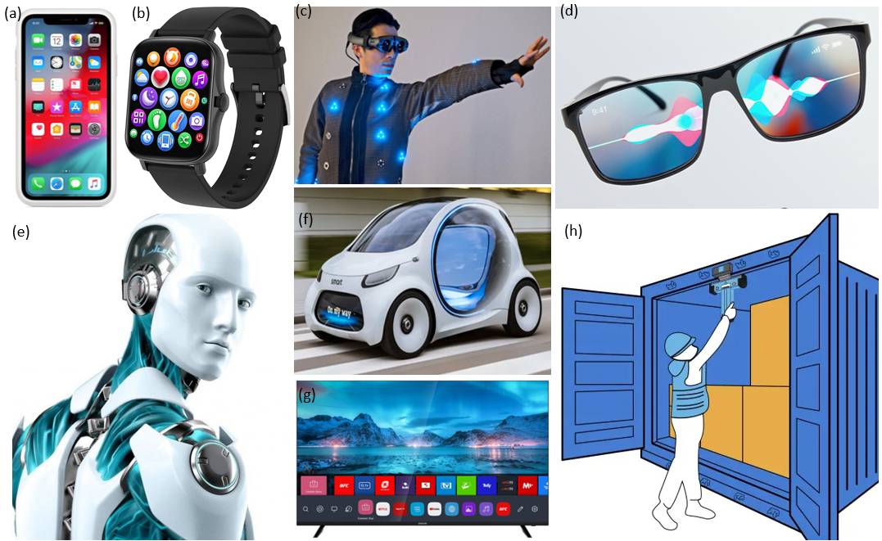
Smart products
Some examples of smart products: smart phone (a); smart watch (b); smart cloth (c); smart glasses (d); smart robot (e); smart self-driving car (f); smart TV (g) and smart container (h)

Slide 7
Applications of smart products
Applications of smart products
Media and entertainment industry
Manufacturing
Mobility
Logistics
Healthcare
Energy
Smart energy grid
Smart clothes
Smart hospitals
Smart packagers
Smart containers
Smart car
Self -driving vehicles
Smart machines
Smart robots
Smart factories
Smart phones
Smart glasses
Smart tablets
Smart TV

Slide 8
Main characteristics of smart products
Huge number of heterogeneous components
Context awareness
Real-time reactivity
High degree of autonomy
High degree of connectivity
High degree of personalization
Self-learning capabilities
Dynamic reconfiguration during the whole lifetime
Human centration
Ease of use

Slide 9
DigiTEX - Textile digitalization based on digital education and innovative e-Tools 2020-1-RO01-KA226-HE-095335
Q & A
Kaunas University of Technology
For further:
reazmbstu.te@gmail.com
md.repon@ktu.edu

