Slide 1
DigiTEX - Textile digitalization based on digital education and innovative e-Tools 2020-1-RO01-KA226-HE-095335
Advanced materials for health care, co-design of actuators-based textiles for rehabilitation
Kaunas University of Technology

Slide 2
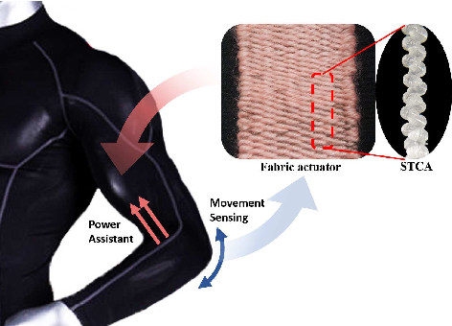
Definitions of Actuator
An actuator is a component of a machine or equipment that aids in generating mechanical force by converting energy, frequently electrical, air, or hydraulic energy. It is, to put it simply, the part of any machine that permits movement. Actuators are devices that can produce work under control.

Slide 3
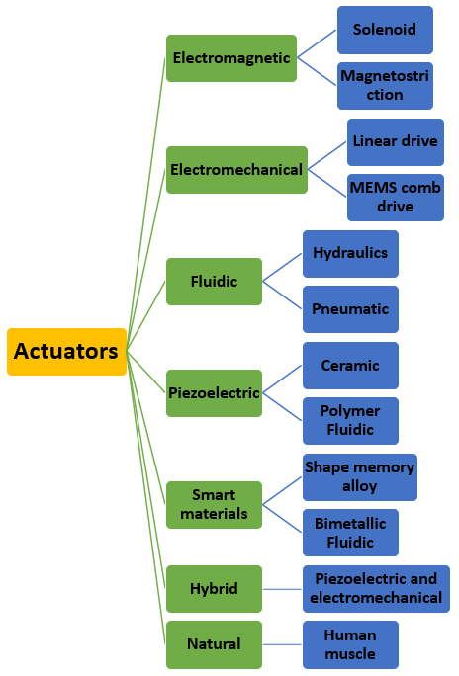
Classifications of flexible actuators

Slide 4
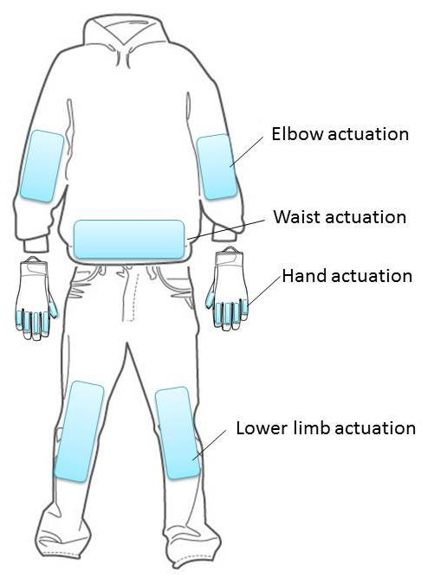
Actuator-based textiles for rehabilitation
A wearable rehabilitation aid suit with DE stack actuators arranged for various help actuations.

Slide 5
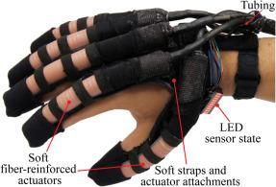
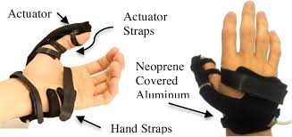
Hand actuation
Pneumatic muscles, which are attached at the back of the fingers, are made specifically to bend fingers. A soft robotic glove with a fluid-driven actuator was able to help the hand's grasping motion.
A hydraulic soft glove for combined assistance and at-home rehabilitation
The developed hand attachment with the incorporated segmented soft actuator

Slide 6
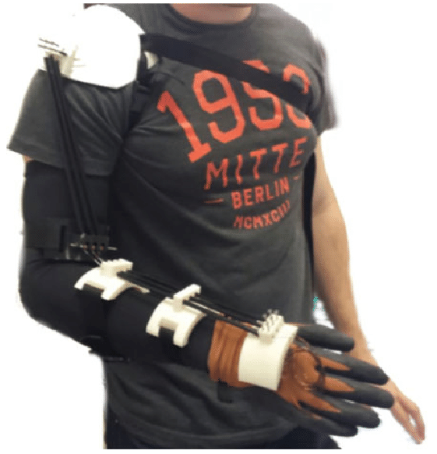
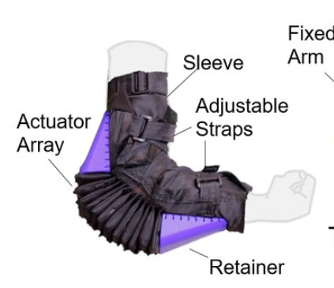
Elbow actuation
The muscles are made to help move the elbow or help the joint regain function. For proper patient elbow joint articulation, a medical rehabilitation exoskeleton using SMA wires as the actuator for the elbow has been proposed.
A medical rehabilitation exoskeleton for proper patient elbow joint articulation
Design of the soft robotic elbow sleeve

Slide 7
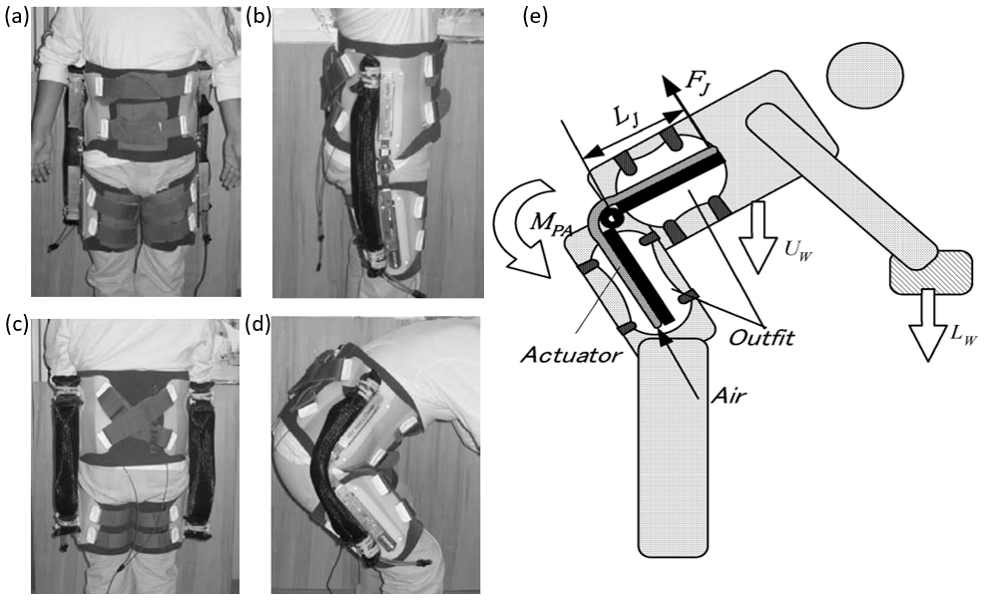
Trunk and waist actuation
The apparatus designed to help waist motion is made up of two stiff pieces joined together by a hinge and attached to pneumatic muscles that have a curved appearance. The human body is equipped with a wearable power assist device to help the muscles perform more efficiently.
(a) front side, (b) flank side (erect), (c) rear side, (d) flank side (anteflexion) and (e) operation principle of waist power assist device

Slide 8
Limb actuation
Upper limbs actuation: The shoulder, arm, and forearm of the upper limb mobility assistance device are joined by two motor-driven joints. The power assist splint for upper arm, created by a research team at Okayama University, powers the wrist and elbow joints to help with upper limb motion. A soft material like a glove is insufficient in this situation to act as an interface with the patient.
Lower limb actuation: The parallel muscles utilized in the active lower limb power the knee joint. The device is designed to give an old or disabled person who can walk, but has trouble sitting and standing up from a seated posture, more independence.

Slide 9
DigiTEX - Textile digitalization based on digital education and innovative e-Tools 2020-1-RO01-KA226-HE-095335
Q & A
Kaunas University of Technology
For further:
reazmbstu.te@gmail.com
md.repon@ktu.edu

